Slide 1
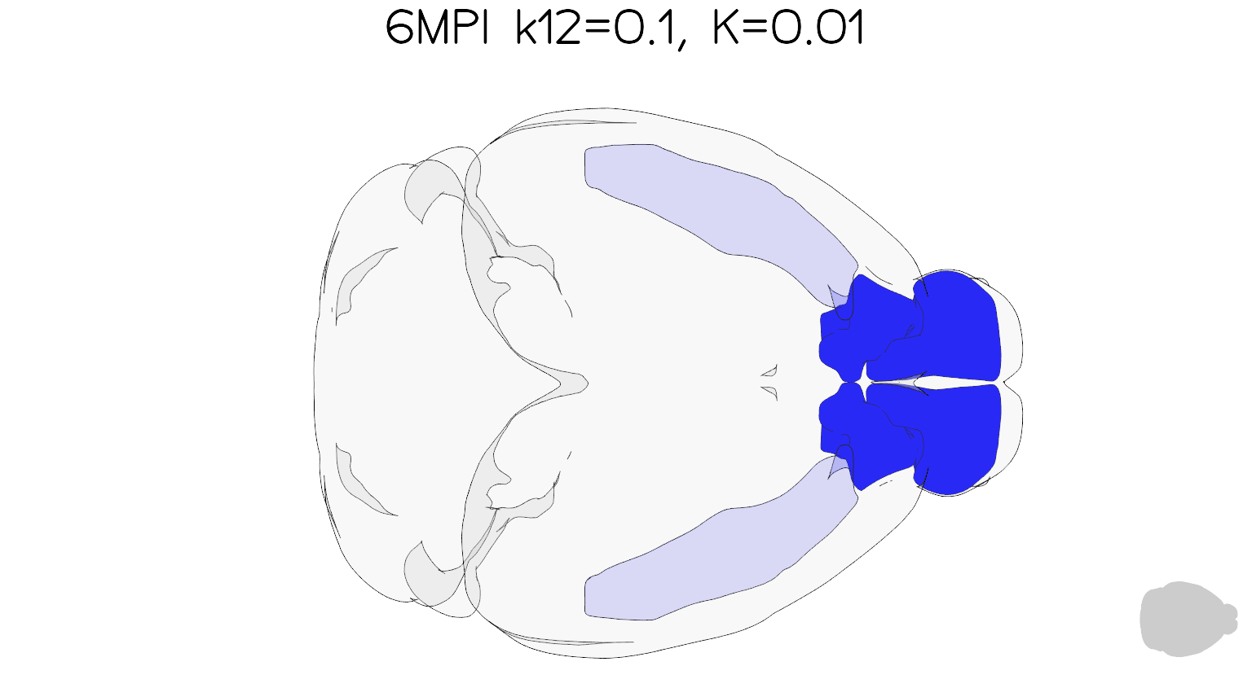
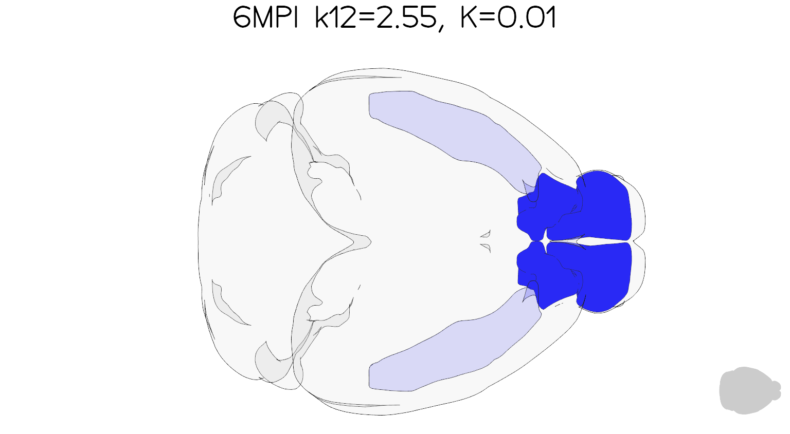
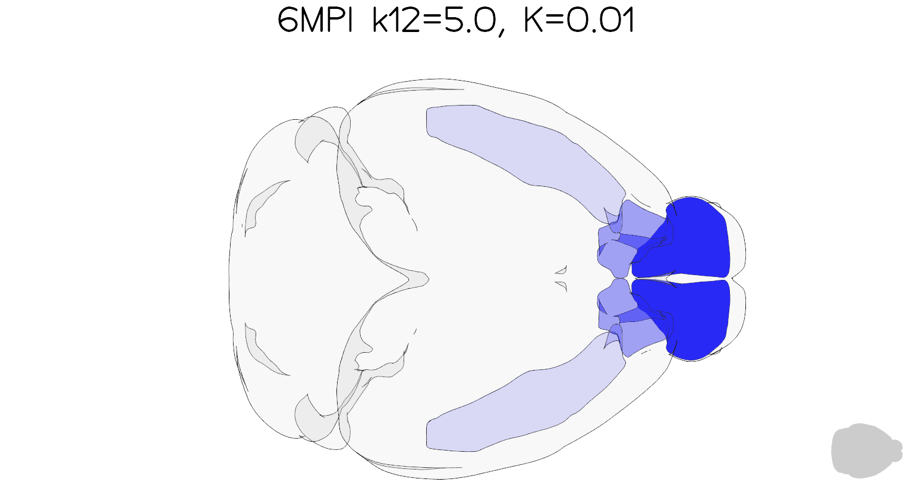
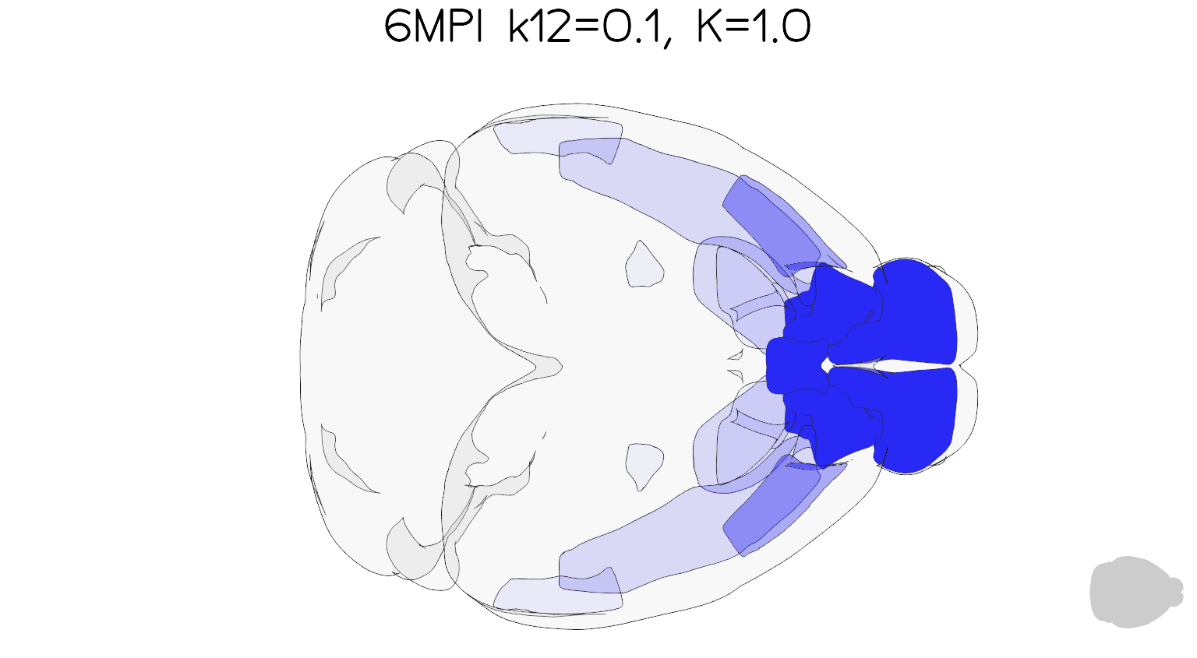

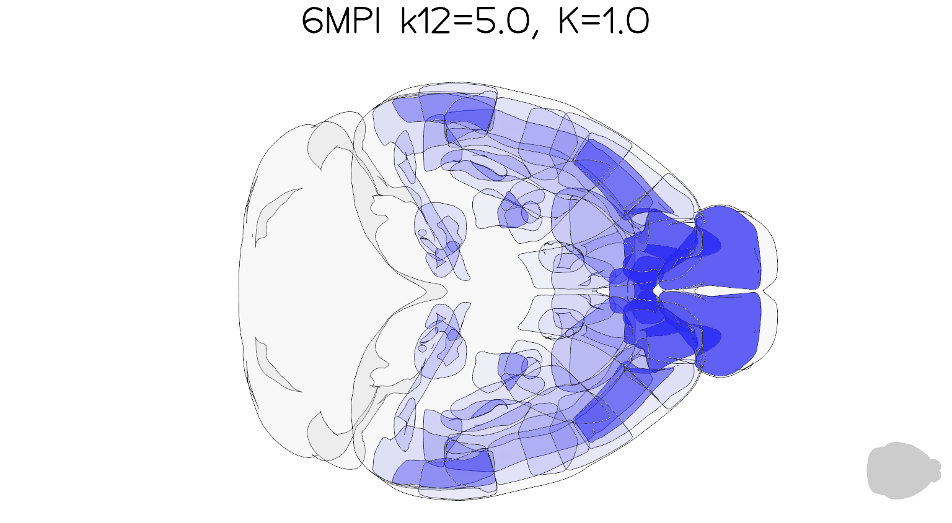

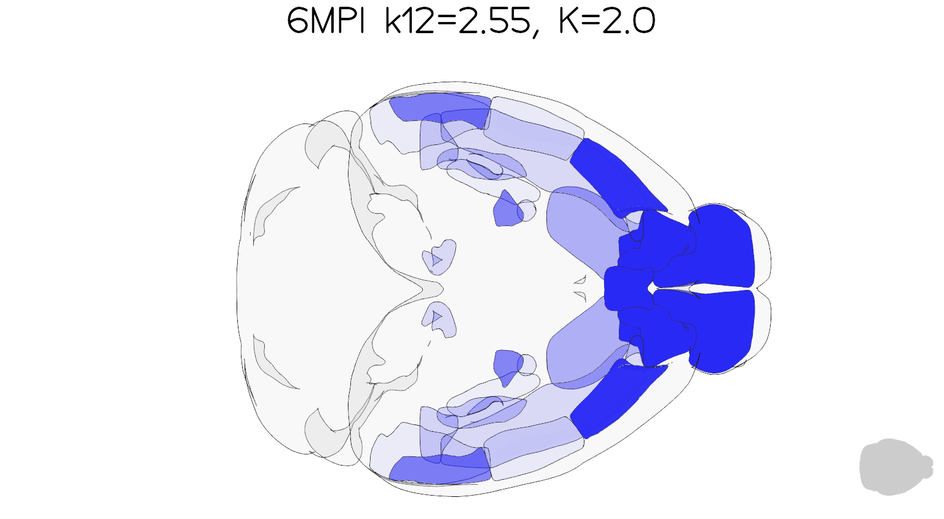
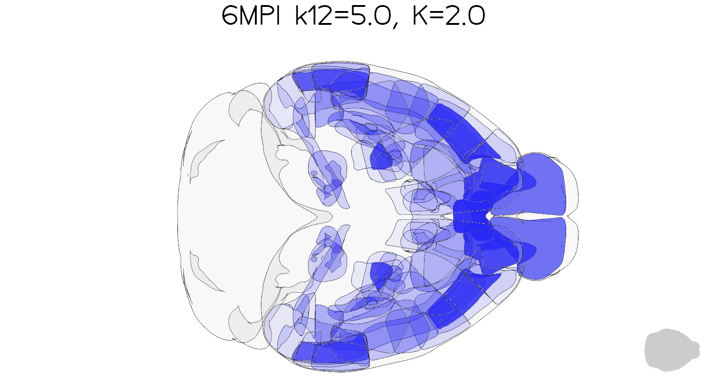
Anterograde Relative Intensities
Increasing k₁₂ (day⁻¹ M⁻¹)
Increasing K (day⁻¹)

Slide 2



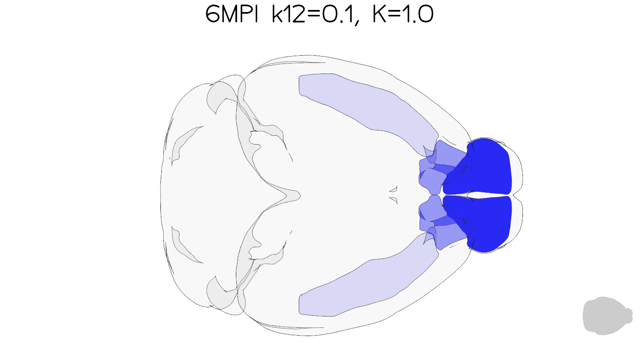



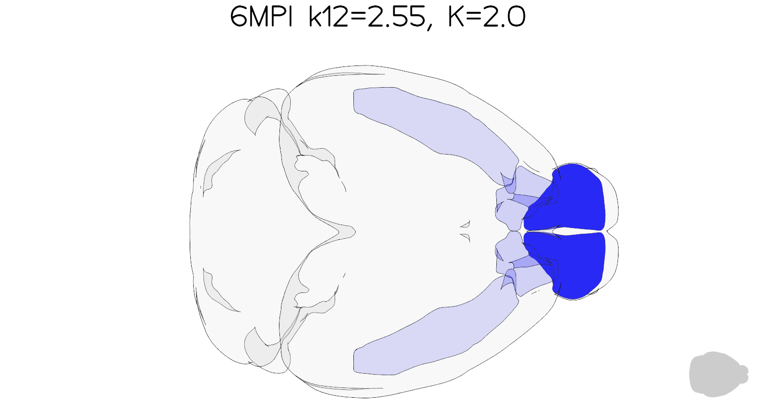

Retrograde Relative Intensities
Increasing k₁₂ (day⁻¹ M⁻¹)
Increasing K (day⁻¹)

Slide 3




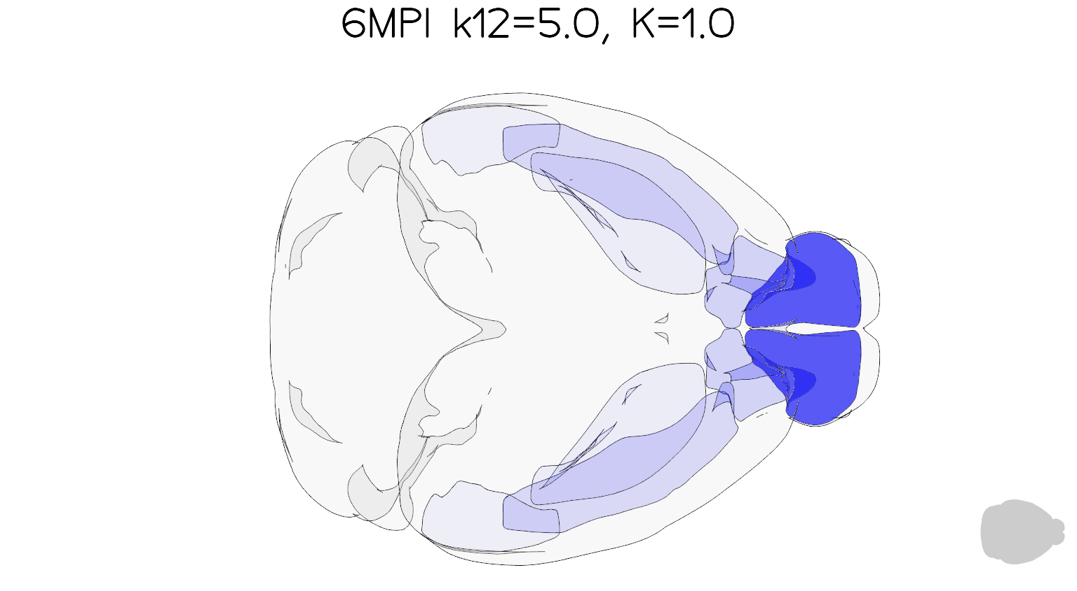


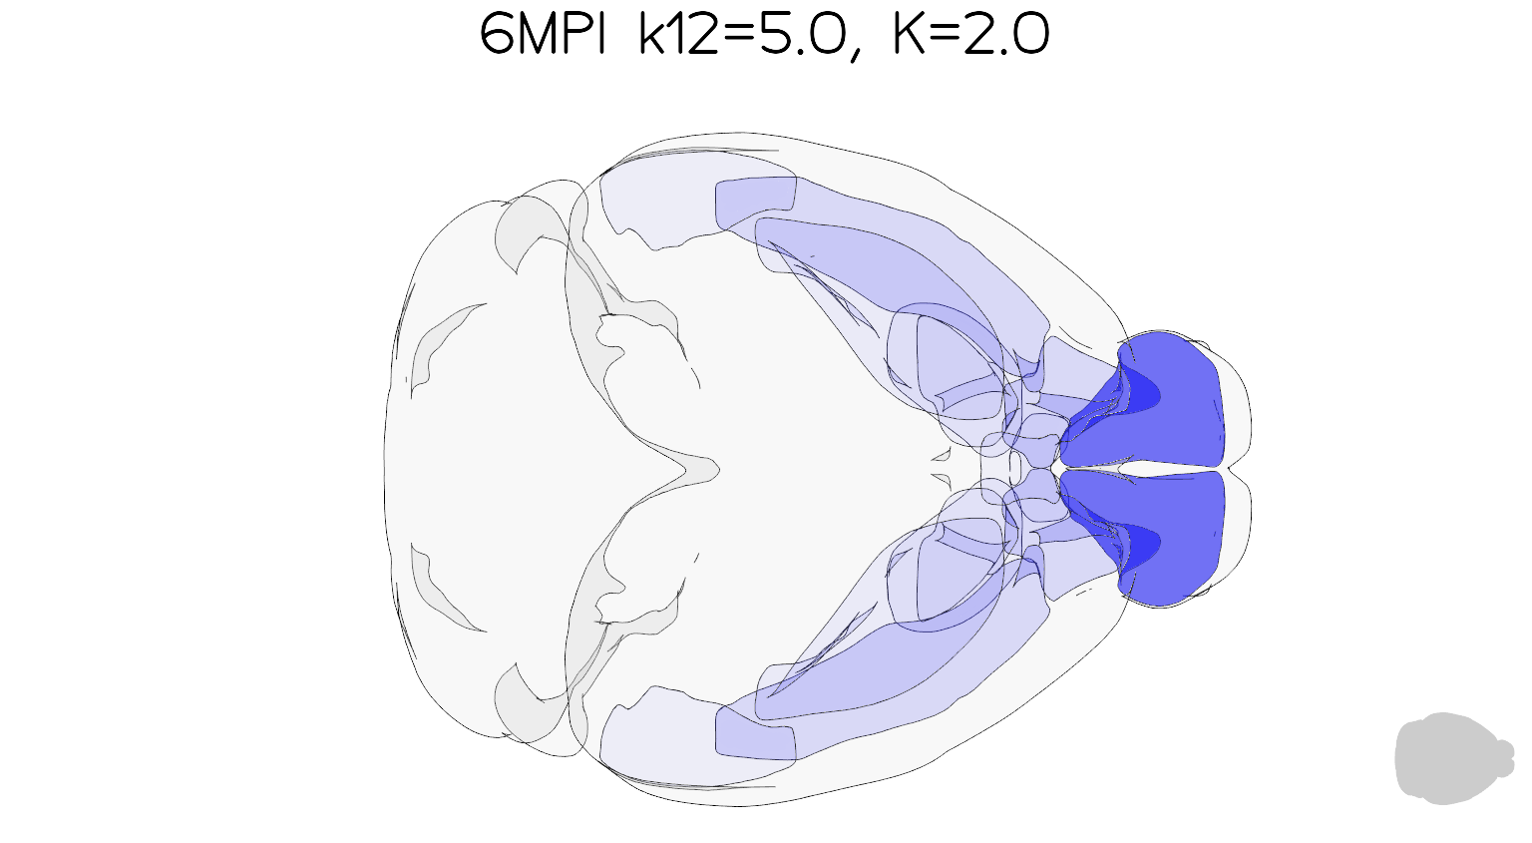
Unbiased Direction Relative Intensities
Increasing k₁₂ (day⁻¹ M⁻¹)
Increasing K (day⁻¹)

Slide 4
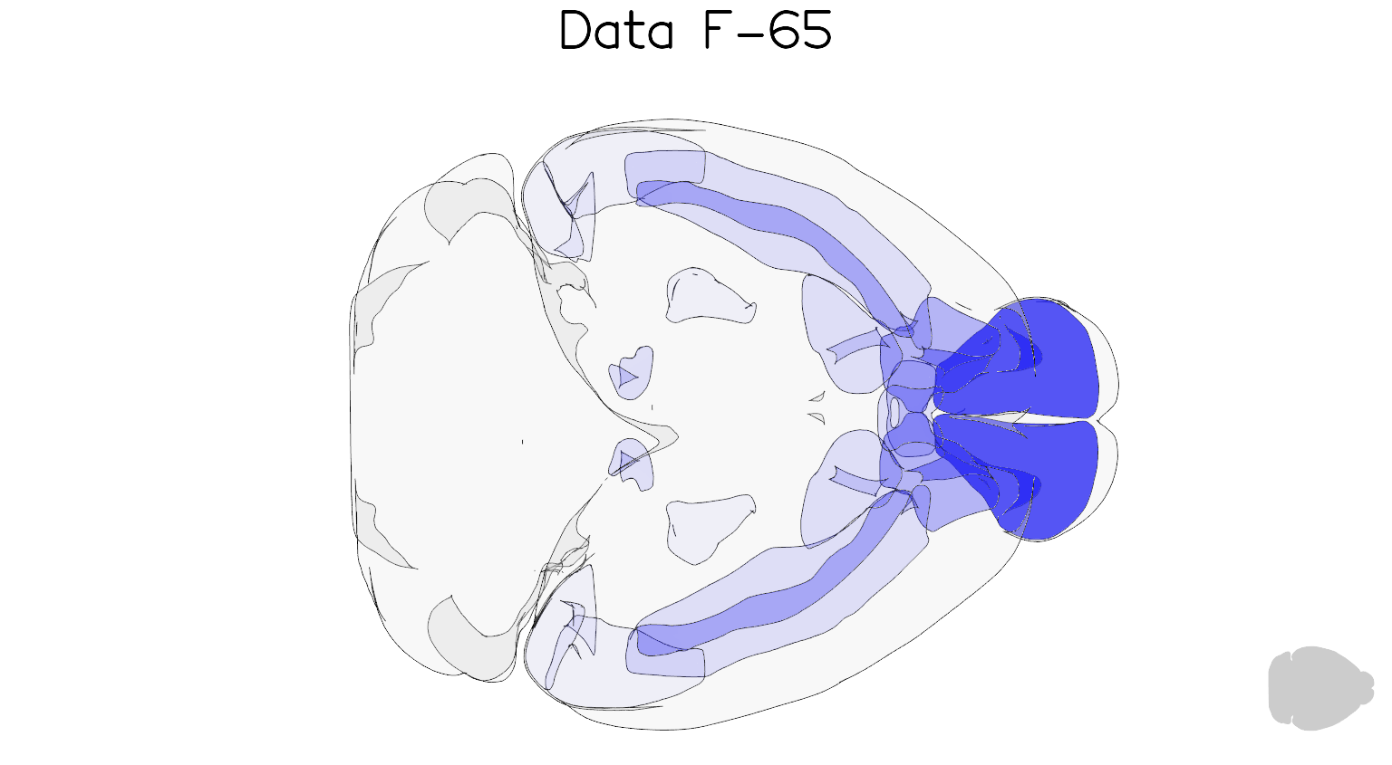
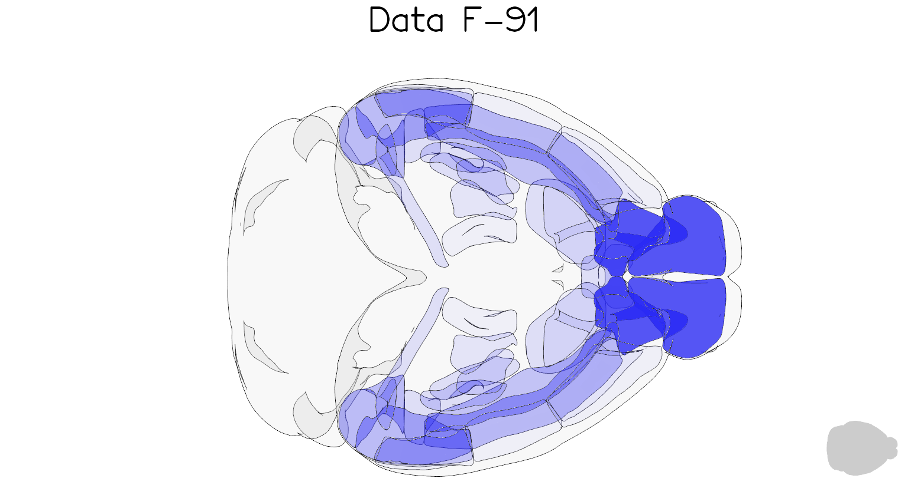
Visual Comparison For F-65 and F-91
Anterograde
Anterograde

Slide 5
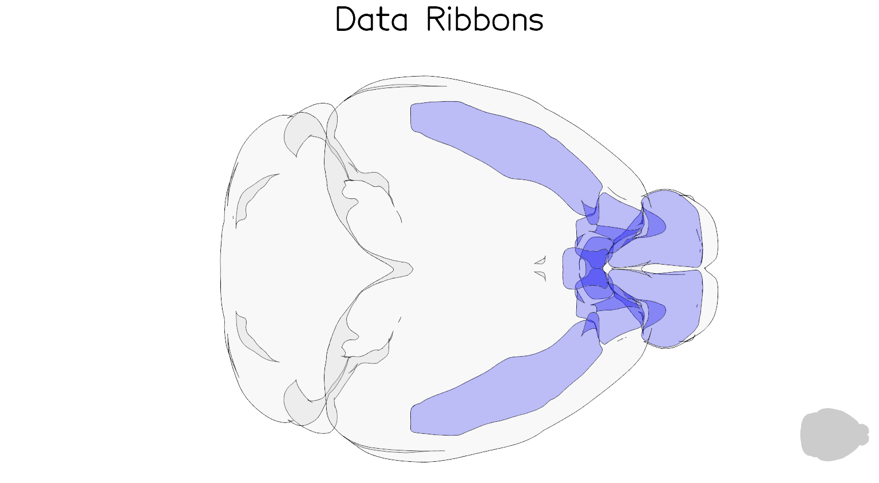
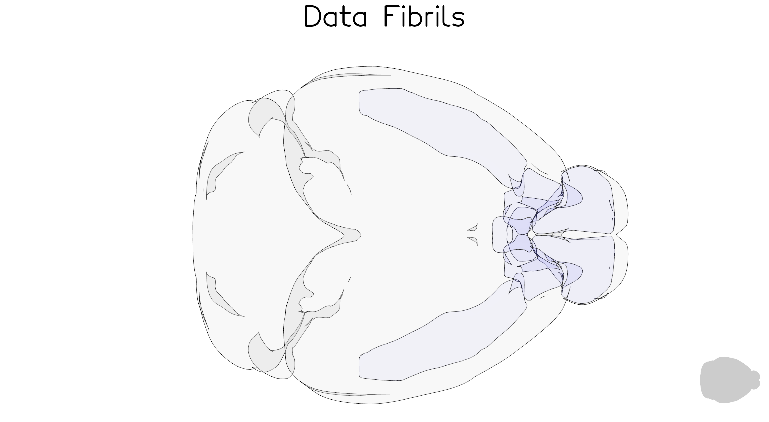
Comparison Between Ribbons and Fibrils, Mach Most Retrograde Patterns
Retrograde Relative Intensities

